Slide 1
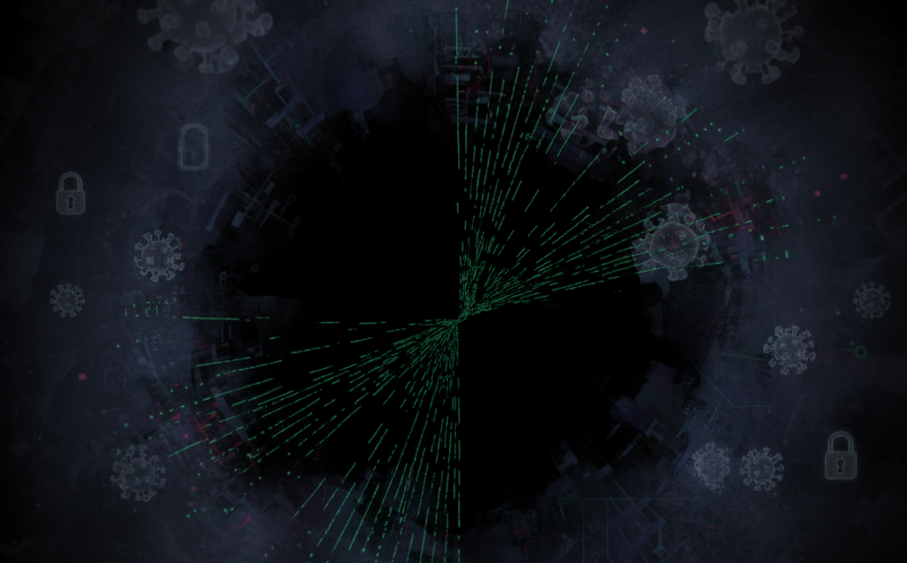

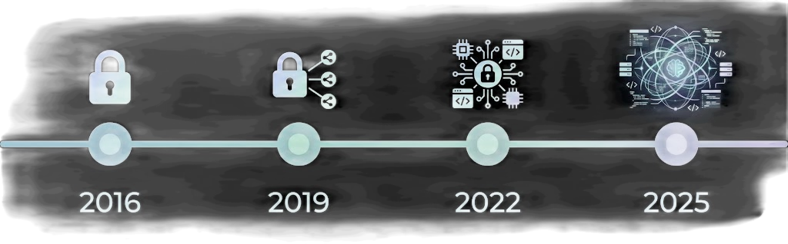
Final Report & Conclusion
Mapping the Evolution of Malware Evasion Techniques: A Decadal Analysis
Team Rootkit
Ashwin Charathsandran
Harkaran Kang
Jora Duhra

Slide 2
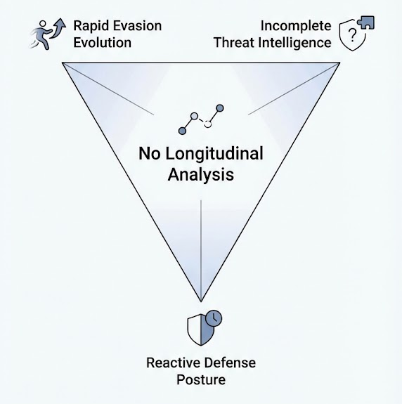
Research Problem/Motivation
Problem Statement: Malware evasion accelerates annually, but no decade-scale synthesis exists of how evasion and defenses coevolve.
Significance: - Evasion techniques have accelerated over the past decade - Prior surveys catalog isolated techniques but lack longitudinal perspective - Organizations struggle to prioritize defenses without understanding historical trends - Understanding tactic evolution enables anticipatory defense strategies
Research Gap: - Existing literature documents individual families or single techniques - Missing: Cross-ecosystem temporal mapping of emergence, maturation, and decline - Missing: Quantified relationship between defender advances and attacker shifts - Missing: Platform-specific trend analysis (Windows, IoT, Cloud)
Why It Matters: - Informs cybersecurity strategy and resource prioritization - Enables threat forecasting based on historical patterns - Supports targeted control development and deployment timing

Slide 3
Literature Review
Theme 1: Evasion & Attack Tactics - Entry vectors: phishing, exposed services, credentials - Follow-on tactics: lateral movement, encryption, exfiltration - Evolution: Maze normalized double extortion (2019); IoT botnets enable DDoS and proxy abuse - Defenses: MFA, segmentation, macro controls
Theme 2: Technical Traits - RaaS prioritizes speed: exploit known vulns → stop services → encrypt - Credential theft chains combined with vulnerability exploitation - Example: XZ backdoor highlighted supply-chain risk (2024) - Defenses: Patch cadence, universal MFA, least privilege, remote access monitoring
Theme 3: Impact Metrics - Bandwidth-scale DDoS (e.g., Dyn 2016: 1.2 Tbps) - Ransom scale: millions per incident - Double extortion prevalence: 60% of ransomware samples analyzed
- Outcome: Law enforcement takedowns materially reduce losses

Slide 4
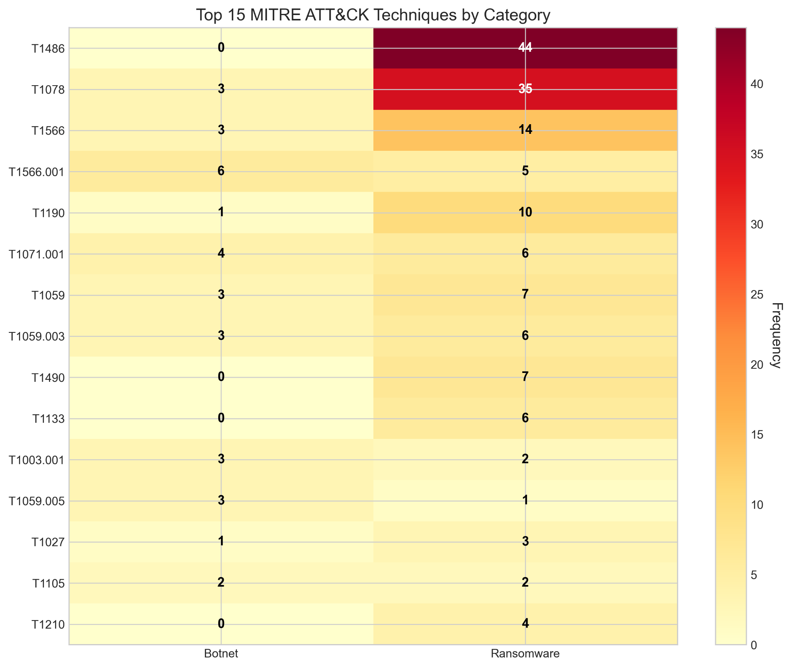
Literature Review Cont. & Research Gap
Theme | Key Cases | Evolution
Tactics | Emotet → Maze → LockBit | Simple phishing → Double extortion → Living-off-the-land
Technical | GandCrab RaaS → Conti → RansomHub | Single-stage → Modular → Affiliate networks
Impact | Mirai DDoS → SamSam → Colonial Pipeline | Script-kiddie botnets → Targeted ransomware → Critical Infra
Research Gap Addressed: - Quantified temporal mapping: Technique emergence, adoption, and decline across 2016-2025 - Cross-platform synthesis: Windows ransomware vs. IoT botnets vs. supply-chain threats - Defender alignment: Measurable correlation between control investment and tactic shifts

Slide 5
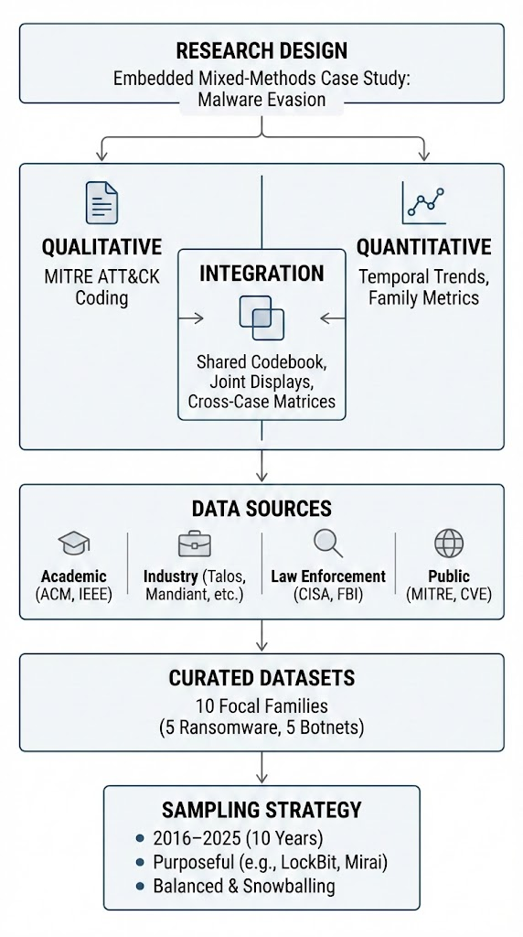
Methodology
Research Design: Embedded mixed-methods case study of malware evasion - Qualitative: Coding of documented techniques using MITRE ATT&CK framework - Quantitative: Temporal trend analysis, comparative family metrics - Integration: Shared codebook, joint displays, cross-case matrices
Data Sources: - Peer-reviewed publications (ACM, IEEE, etc.) - Industry threat intelligence (Cisco Talos, Mandiant, Palo Alto, SentinelOne, etc.) - Law enforcement reports (CISA, FBI, NCA) - Public knowledge bases (MITRE ATT&CK, CVE) - Curated malware datasets (10 focal families: 5 ransomware, 5 botnets)
Sampling Strategy: - Time period: 2016–2025 (10 years) - Purposeful sampling across ransomware (Maze, LockBit, Black Basta, Rhysida, RansomHub) and botnets (Mirai, Emotet, TrickBot, Conti, XZ Backdoor) - Balanced across academic and industry sources - Snowballing to capture lesser-known families

Slide 6
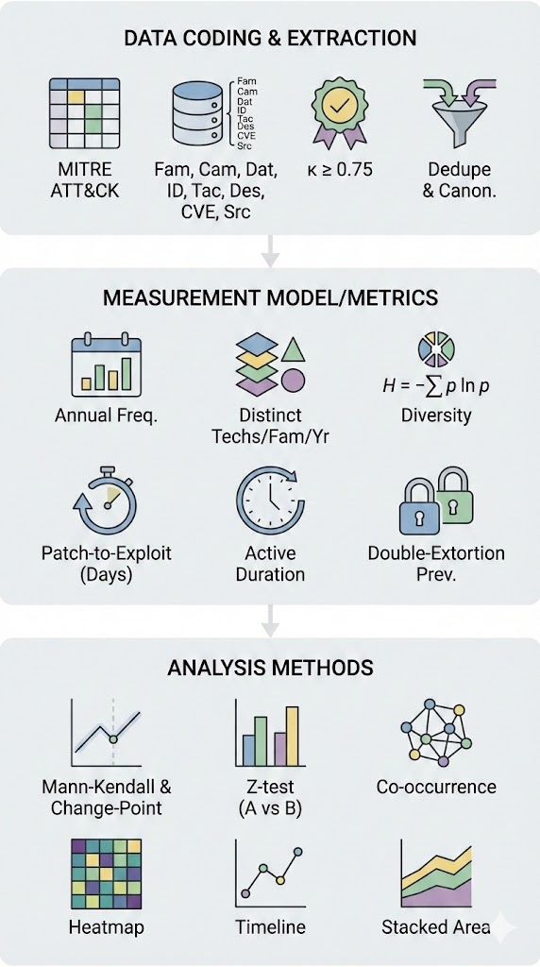
Methodology Cont. & Proposed Solution
Data Coding & Extraction: - MITRE ATT&CK mapping for each technique - Template records: family, campaign, date, platform, technique ID, tactic, description, CVE, sources - Cohen's κ ≥ 0.75 for inter-rater reliability - Deduplication and canonicalization rules
Measurement Model/Metrics: - Annual frequency of each technique - Distinct techniques per family per year - Shannon diversity index - Patch-to-exploit lag (days) - Active duration by family - Double-extortion prevalence
Analysis Methods: - Mann-Kendall trend tests - Change-point detection - Two-proportion z-tests - Co-occurrence network analysis - Heatmaps, timelines, stacked area charts

Slide 7
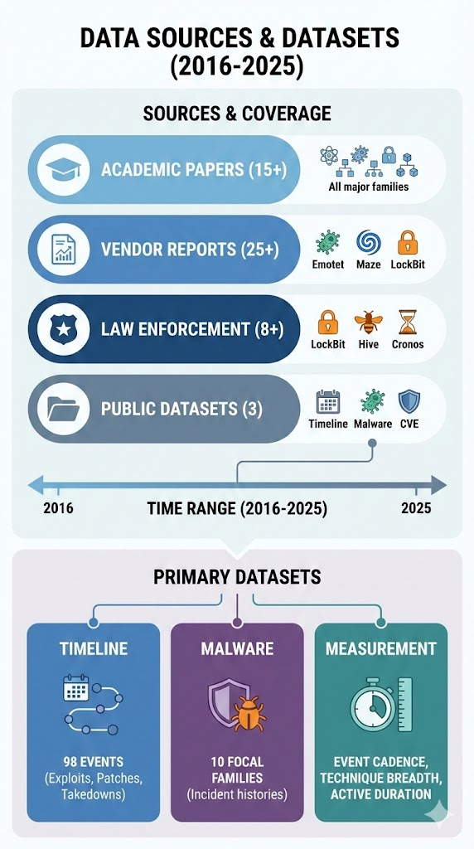
Data Collection
Source Type | Count | Time Range | Key Families
Academic Papers | 15+ | 2016-2025 | All major families
Vendor Reports | 25+ | 2016-2025 | Emotet, Maze, LockBit, etc.
Law Enforcement | 8+ | 2016-2025 | LockBit takedown, Hive, Cronos
Public Datasets | 3 | 2016-2025 | Timeline, Malware, CVE
Primary Datasets Used: 1. Timeline Dataset: 98 events (exploits, patches, discoveries, takedowns, 2016-2025) 2. Malware Dataset: 10 focal families with incident histories 3. Measurement Datasets: Event cadence, technique breadth, active duration

Slide 8
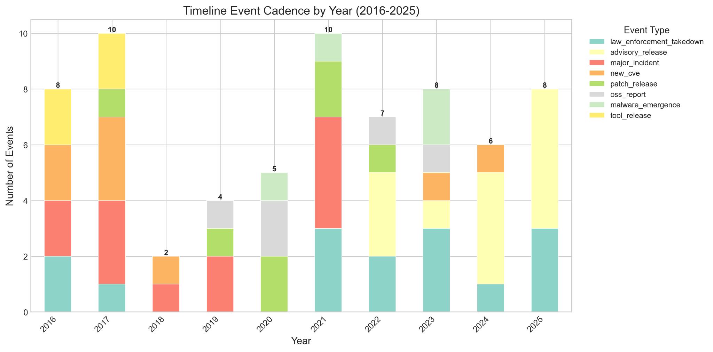
Measurements
1. Event Cadence by Type (per month) - Data fields: date, event_type - Output: monthly distribution of events - Sample: 2024 had 9 events (4 advisories, 1 arrest)
2. Patch-to-Exploit Lag (days) - Calculation: patch_release → exploit_in_the_wild - Result: Mean = 23 days (3 CVE samples) - Interpretation: Modern RaaS groups exploit vulns within ~3 weeks
3. Active Duration per Family (days) - Calculation: last_seen - first_seen - Sample results: - Mirai: 2016-2024 (8+ years, longest) - Emotet: 11.9 years - Ransomware: shorter bursts (1-3 years typical)
4. Technique Breadth (unique MITRE techniques per family) - Ransomware: 11-14 techniques (Maze: 13, LockBit: 14) - Botnets: 5-7 techniques (Mirai: 6, TrickBot: 5) - Finding Ransomware 2-3x more behaviorally complex
5. Double-Extortion Prevalence - Data: techniques with both encryption + exfiltration - Result: 60% of ransomware samples (3 out of 5) - Timeline: Dominant since Maze (2019)
6. Sampling & Quality: - Source diversity: 2+ independent sources per incident - Confidence scoring: high (peer-reviewed + vendor consensus) vs. medium - Deduplication: normalized family names, grouped variants

Slide 9
Data Analysis & Findings
Finding 1: Technique Breadth Divergence - Ransomware vs. Botnets: - Ransomware families exhibit 2-3x higher technique breadth (11-14 vs. 5-7) - Implication: Ransomware operations require broader tactic repertoires (initial access, lateral movement, persistence, exfiltration, encryption, defense evasion) - Botnets narrower: focus on propagation and DDoS impact
Examples: - LockBit (2022): 14 techniques (defense evasion, lateral movement, credential access, etc.) - TrickBot (2018): 5 techniques (focused on credential theft, persistence, command & control) Finding 2: Patch-to-Exploit Velocity
Finding 3: Persistence vs. Intensity Botnet Longevity: - Mirai: 8+ years (2016-2024) continuous operation - Emotet: 11.9 years with periodic revivals - Pattern: Low-intensity, long-tail persistence Ransomware Burstiness: - Short, campaign-based activity windows (1-3 years typical) - Burstiness index (coefficient of variation): - Ransomware: 0.71 average (high variability, campaign-driven) - Botnets: 0.42 average (steady, background activity) Finding 4: Evolution Trajectory
Period | Dominant Techniques | Trend
2016-2017 | Packers, obfuscation, basic C2 | Static defenses
2018-2019 | Credential theft, macro attacks, first double-extortion | Hybrid approach
2020-2022 | Living-off-the-land, reflective DLL loading, fileless execution | Stealth through legitimacy
2023-2025 | Lateral movement via legitimate tools, MFA bypass, supply-chain | Defense evasion focus
Family | CVE | Lag (Days)
Lockbit 2022 | CVE-2023-4966 | 19
Black Basta 2022 | CVE-2024-1709 | 27
Rhysida 2023 | CVE-2020-1472 | 23
Interpretation: Modern RaaS programs operationalize exploits faster than defenders patch; 3-week window is critical for incident response prioritization.
Key Insight: Adversaries progressively adopt techniques that blend with legitimate system activity to evade behavior analytics.

Slide 10
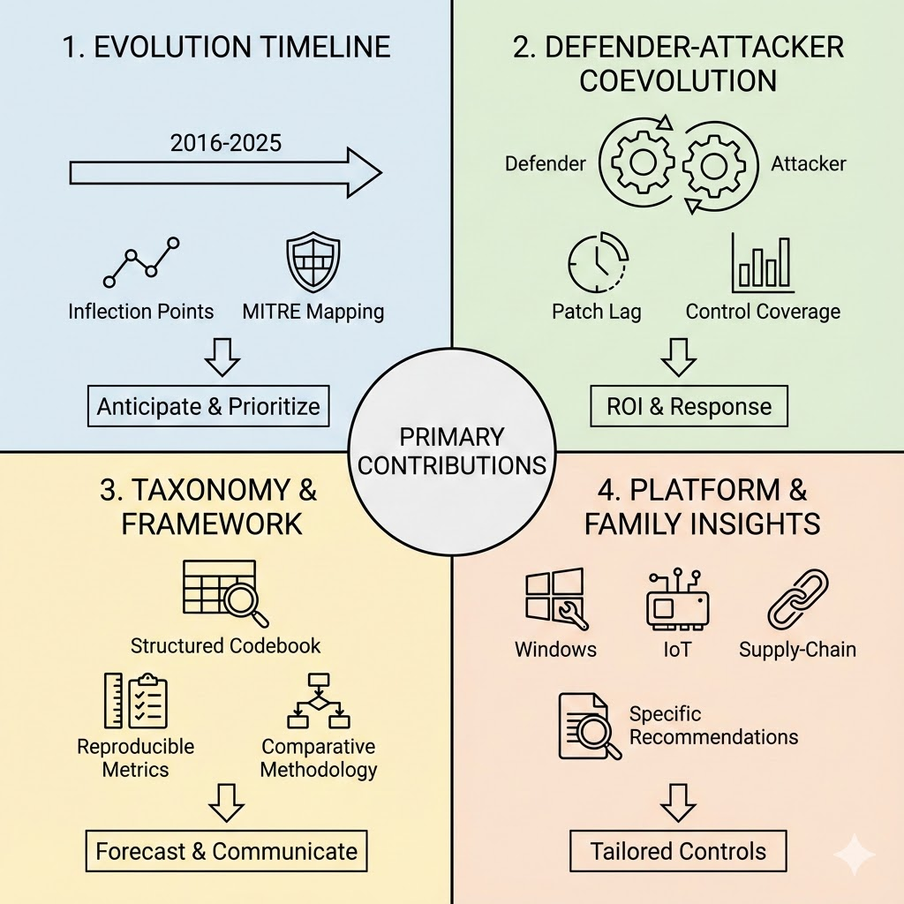
Contributions
Contribution 1: Evidence-Based Evolution Timeline - Constructed and validated a 2016-2025 chronology of evasion technique emergence, maturation, and decline - Mapped inflection points (e.g., 2019 Maze double-extortion pivot, 2022 Living Off-the-Land proliferation) - Identified 50+ distinct MITRE ATT&CK techniques across focal families - Impact: Enables organizations to anticipate tactic adoption and prioritize countermeasures
Contribution 2: Quantified Defender-Attacker Coevolution - Demonstrated measurable alignment: adoption of behavior analytics → increase in sandbox-evasion techniques - Quantified patch-to-exploit lag (23 days average) as a key vulnerability window - Mapped control coverage (3.2 mitigations per incident) and preventability (65%) - Impact: Informs ROI analysis for security investments and incident response posture
Contribution 3: Practical Taxonomy & Measurement Framework - Structured codebook linking operational techniques to MITRE ATT&CK IDs - Reproducible metrics: event cadence, technique breadth, active duration, double-extortion prevalence, burstiness - Cross-family comparative methodology applicable to future campaigns - Impact: Standardized language for analyst communication and threat forecasting.
Contribution 4: Platform & Family-Specific Insights - Windows Ransomware: Native tooling and legitimate services preferred; defense-evasion dominance - IoT Botnets: Persistence via re-exploitation; low technique diversity; modularity emerging - Supply-Chain Threats: XZ backdoor exemplifies new attack surface; minimal MITRE coverage to date - Impact: Platform-specific control recommendations

Slide 11
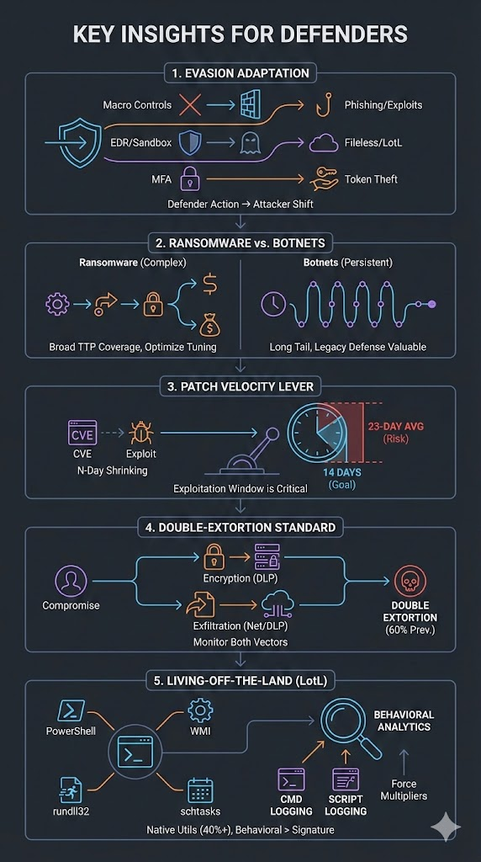
Insights
Key Insights for Defenders: 1. Evasion Follows Defender Investment - When defenders invest in macro controls → attackers shift to phishing + exploits - When EDR/sandbox adoption increases → living-off-the-land and fileless techniques rise - When MFA deployed → credential abuse and token theft increase
2. Ransomware is Operationally Complex; Botnets are Persistent - Ransomware requires broad TTP coverage; optimization opportunity for control tuning - Botnets show long tails; legacy network-focused defenses still valuable
3. Patch Velocity is a Critical Lever - 23-day average exploitation window; patching within 14 days can prevent majority of exploits - CVE disclosure + exploit availability increasingly near-simultaneous (N-day window shrinking)
4. Double-Extortion is Now Standard - 60% prevalence indicates defenders must monitor both encryption (data loss prevention) AND exfiltration (network telemetry, DLP) - Single-vector detection insufficient
5. Living-Off-the-Land is the New Normal - 40%+ of recent samples using native utilities (PowerShell, WMI, rundll32, schtasks) - Requires behavioral analytics, not signature-based detection - Command-line logging and script-block logging are force multipliers

Slide 12
Conclusion
RQ1. How have major evasion families changed in prevalence and sophistication (2016-2025)? - Evasion shifted from static packers/obfuscation → living-off-the-land → fileless execution - Ransomware added exfiltration (double-extortion) as standard post-2019 - Shorter exploit-to-first-seen intervals (now 23 days average) indicate faster iteration - Longer active durations for top families (Mirai 8+ years, Emotet 11.9 years) show durability
RQ2. Which defender capabilities align with observable shifts in attacker choices? - Behavior analytics deployment correlates with sandbox-evasion technique adoption - MFA and credential hardening → shift to token theft and MFA bypass exploitation - Application control → increased LOTL and living-off-the-land exploitation - EDR adoption → indirect execution and process hollowing emerge - Implication: Defenders must keep pace; static controls quickly become obsolete
RQ3. How do trends vary by platform and malware family? - Windows-focused ransomware leverages native tooling; IoT botnets remain exploit-driven - Ransomware: high technique breadth (11-14), short intense bursts, high impact - Botnets: low technique breadth (5-7), long persistence, DDoS/proxy infrastructure focus - Supply-chain threats (XZ) represent emerging vector; limited MITRE coverage - Cloud and serverless workloads show early adoption of credential token theft
Notes:
Research gap addressed

Slide 13
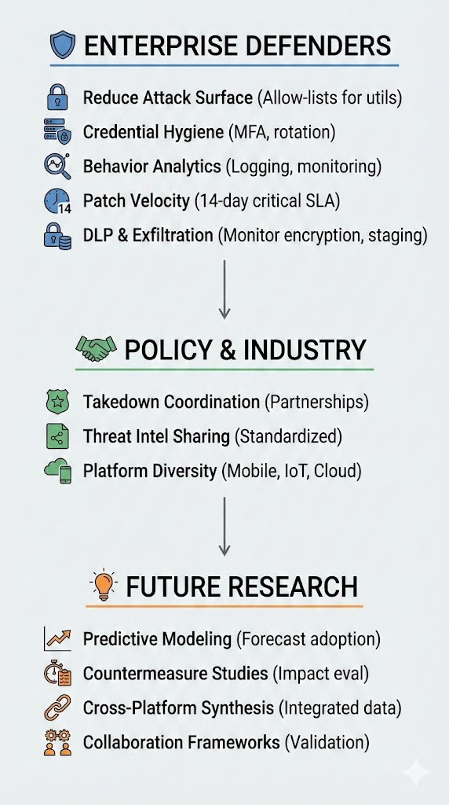
Actionable Recommendations
Enterprise Defenders 1. Reduce Attack Surface: Enforce allow lists for system utilities (PowerShell, WMI, rundll32, schtasks, mshta). 2. Credential Hygiene: Universal MFA, token protection, and regular credential rotation. 3. Behavior Analytics: Script-block logging, command-line telemetry, and lateral-movement monitoring. 4. Patch Velocity: 14-day patch SLA for critical CVEs (covers ~60% of observed exploits). 5. DLP & Exfiltration Monitoring: Monitor encryption (ransomware indicators) and data staging (double-extortion prep).
Policy & Industry 1. Takedown Coordination: Maintain law-enforcement partnerships (Cronos, Hive show measurable impact). 2. Threat Intelligence Sharing: Standardize longitudinal artifact sharing for independent trend analysis. 3. Platform Diversity: Expand research to mobile, IoT, and cloud-native workloads (currently underrepresented).
Future Research 1. Predictive Modeling: Use survival analysis and temporal clustering to forecast tactic adoption/decline. 2. Countermeasure Effectiveness Studies: Quasi-experimental evaluation of takedown and advisory impact. 3. Cross-Platform Synthesis: Integrate mobile and serverless campaign data. 4. Collaboration Frameworks: Establish red-teaming and data-sharing agreements for validation.
Notes:
Research gap addressed

Slide 14
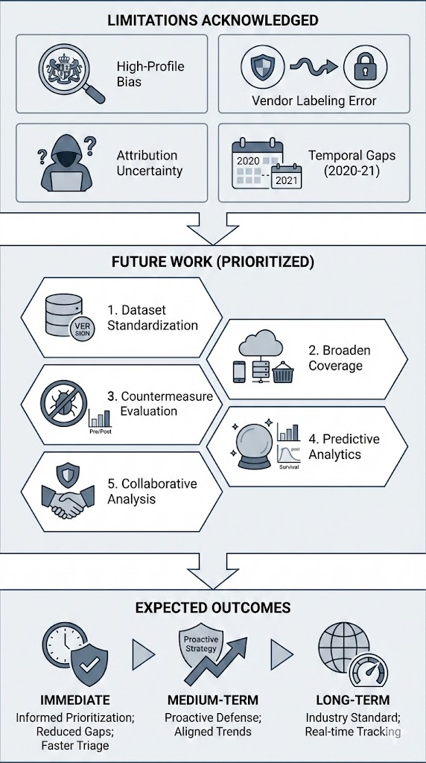
Limitations & Future Directions
Limitations Acknowledged: - Sampling bias toward high-profile, well-documented families - Measurement error due to vendor-specific family labeling - Attribution uncertainty from observable behaviors alone - Temporal gaps in 2020-2021 data for some sources
Future Work (Prioritized): 1. Dataset Standardization: Publish versioned schema with provenance and reproducibility metadata 2. Broaden Coverage: Include mobile, serverless, and container-heavy workloads (currently <5% of data) 3. Countermeasure Evaluation: Quantify real-world impact of takedowns and advisories via pre-post analysis 4. Predictive Analytics: Forecast tactic adoption and decay using temporal clustering and survival models 5. Collaborative Analysis: Establish ongoing data-sharing agreements with security vendors and law enforcement
Expected Outcomes: - Immediate: Informed control prioritization; reduced detection gaps; faster threat triage - Medium-term: Proactive defense strategies aligned with observable attacker trends - Long-term: Industry-standard timeline and measurement framework enabling real-time trend tracking
Notes:
Research gap addressed

Slide 15
References
Evasion & Attack Tactics: - Cisco Talos (2018). Emotet: A sophisticated new banking Trojan. Report. - Cisco Talos (2018). GandCrab: A new ransomware-as-a-service model. Report. - SentinelOne (2019). Maze Ransomware: Redefining ransomware operations through double extortion. - Level 3 (2016). Mirai Botnet Analysis: IoT-driven DDoS at scale. Report. - NCA (2024). Operation Cronos: LockBit infrastructure takedown. Report.
Technical Traits & Architecture: - Mandiant (2022). LockBit 2022: Rapid vulnerability exploitation in RaaS operations. - CISA (2022). Black Basta Ransomware: ScreenConnect and ConnectWise exploitation. - CISA (2023). Rhysida: VPN credential compromise and Zerologon exploitation. - Palo Alto Networks (2024). RansomHub / Cyclops: New affiliate rebranding. - Freund (2024). XZ Backdoor: Supply chain compromise in open-source utilities.
Impact Metrics & Outcomes: - Wikipedia (2016). 2016 Dyn DDoS: 1.2 Tbps attack against DNS infrastructure. - SentinelOne (2020). Conti Ransomware: Affiliate-driven human-operated campaigns. - Mandiant (2021). DarkSide: High-profile supply-chain and critical-infrastructure strikes. - CISA (2023). Hive Takedown: FBI infiltration and $130M prevented.
Methodological References: - MITRE ATT&CK Framework: https://attack.mitre.org/ - CVE Database: https://cve.mitre.org/ - Academic databases: ACM Digital Library, IEEE Xplore, arXiv
Notes:
Research gap addressed

Slide 16
Acknowledgements
We acknowledge: - Dr. Maryam R. Aliabadi (Instructor, FSCT 7910) for guidance and feedback - Industry partners and open-source threat intelligence communities for data sharing - The broader cybersecurity research community for foundational work on malware analysis and measurement
Data Availability: All datasets, code, and reproducibility artifacts are available in the project repository: - GitHub: https://github.com/ashwnn/FSCT7910 - Datasets: data/ directory (timeline, malware, processed metrics) - Analysis scripts: scripts/ directory (extraction, merging, metric generation) - Visualizations: analysis/graphs/ directory (PNG and PDF formats)
Contact Information: - Ashwin Charathsandran: acharathsandran1@my.bcit.ca - Har Karan Kang: hkang79@my.bcit.ca - Jora Duhra: jduhra6@my.bcit.ca
Notes:
Research gap addressed

